Slide 1
Online Registration
Notes:
Thank you for having us! We’re excited to share with you some of the exciting things the BSA Information Delivery Group has been developing to help make your job and life easier!
(click)

Slide 2
What is it?
New method of registering new Scouts as members of BSA without a paper application
Currently, not available for transfers or Adult applications
New method of tracking leads and inviting Scouts to join your unit

Slide 3
Why?
Today’s young families live online
System to manage recruitment/streamline workflow
Built-in membership validation
Digital signatures accepted
Able to pay online with credit card
Dashboards for lead/application status
Regular status notifications sent to unit key 3
Works well at Join Scout Nights
Parents can print membership cards
Welcome packet sent to new members
Notes:
Invitations to join can be sent by email and system tracks these prospective new members
System automatically checks for required information – no applications rejected because of incomplete or illegible information
Lead and application status can be viewed simultaneously by all key leaders
No paper to lose
Works well at Join Scout Nights
Parents enter email address into invitation manager
Unit sends invitation to these parents
Parents can complete applications on smart phone, tablets, etc.
Unit can approve the application and complete the process that night
No need for a trip to council office
Parents can print membership cards online
A welcome packet is sent automatically by email to new members and it includes introductory information from BSA National, a link to the council web site, and a short custom message from the unit (if configured)

Slide 4
Agenda
Be prepared!
  My.Scouting
  BeAScout
  Unit Configurations
Invitation Manager overview
Digital Application overview
Application Manager overview
Online Registration Resources
  www.Scouting.org/onlineregistration
Notes:
The new online registration tool went live last June and allows your unit to sign new members up digitally and complete the entire acceptance process without having to handle a any paper. This system allows for digital signatures and online credit card payment making it fast and easy for the new applicant.
There are a few things that the unit needs to do to ensure an easy process – we will go over that
I will show you the Invitation Manager tool
The digital application that the applicant will fill out
The Application Manager tool
And, the online resources available to help you use the system.
(click)

Slide 5
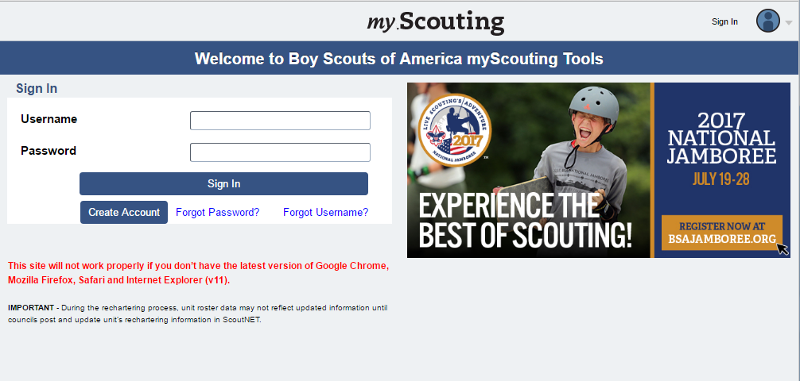
my.scouting.org
Notes:
Online registration administration tools for units are accessed through your My.Scouting account. If you don’t currently have an account, you will need to create one to use Online Registration. If you do have an account, make sure that your email address and the rest of your profile is current so that you get notifications and information that you need to use the new tools.
The tools contained within My.Scouting are role based. Therefore your unit needs to have the Unit Key 3 correctly registered so that they can take action in the system. So if you change Committee Chairs or your top leader, you need to get that information in to the council as soon as possible so that they can be registered correctly which will enable access to these tools.
Page 4 of the Online Registration Unit Guidebook walks you through the steps to update your My.Scouting account.
(click)

Slide 6
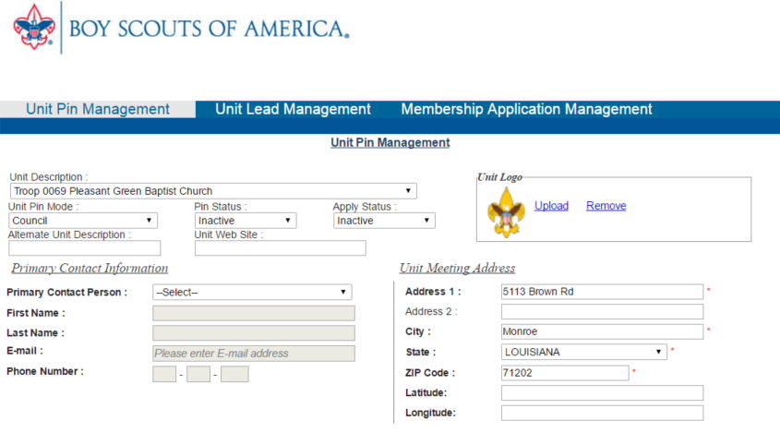
BeAScout Unit Pin
Notes:
While in your My.Scouting account, someone in the Unit Key 3 – The Committee Chair, top unit leader (Cubmaster, Scoutmaster, Crew Advisor, Coach, or Skipper), or Chartered Organization Representative – should go in to the BeAScout set up that can be found under legacy tools.
(click) Under unit pin management,
(click) verify that the contact information updated and correct.
(click) Also set the unit pin to Unit mode, Pin Status to Active, and Apply Status to active so “Apply Now” button shows on BeAScout. If Apply Status is not set to active only the “Request More Information” button will show on BeAScout.
(click)

Slide 7
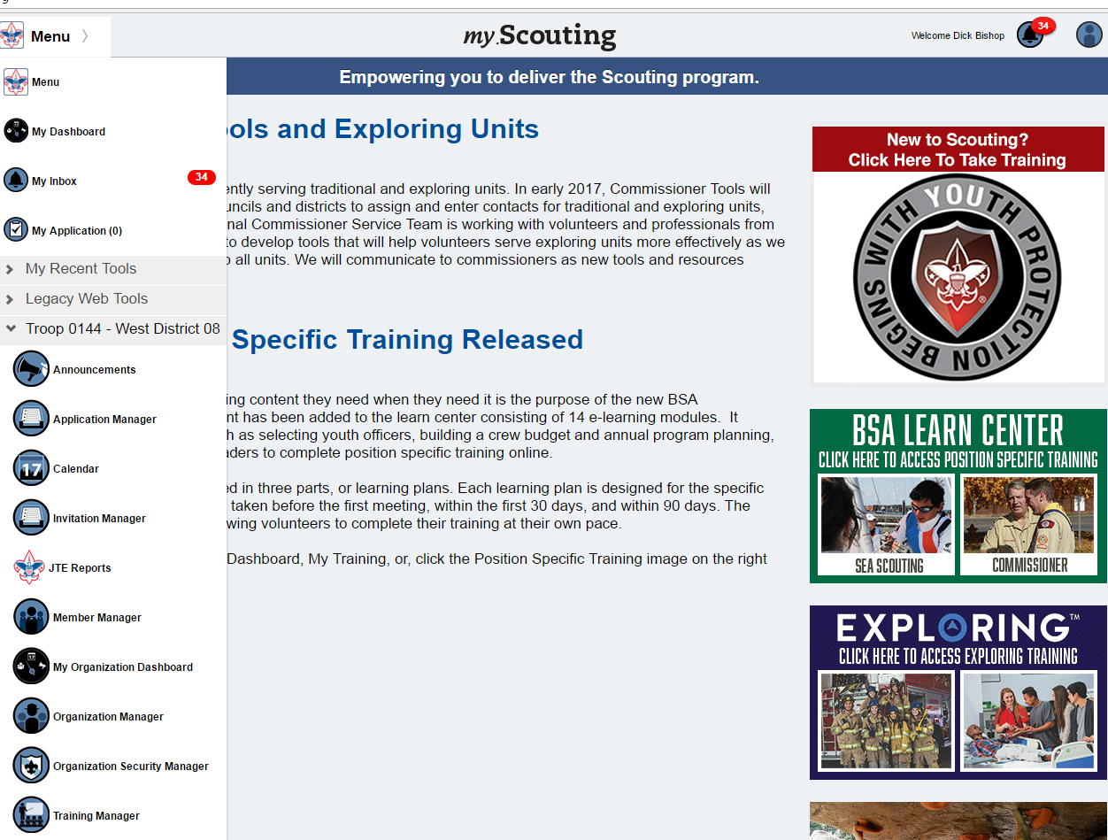
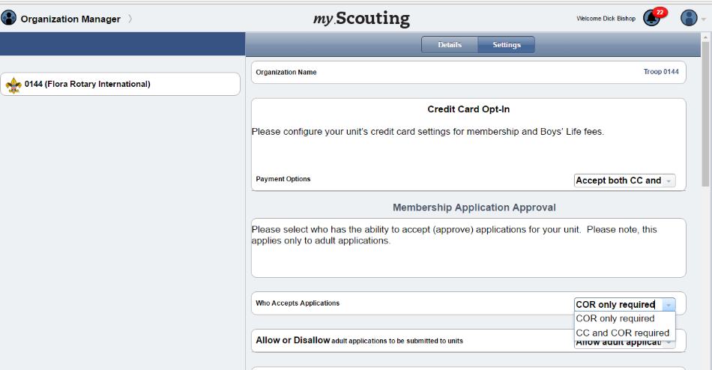
Unit Configurations
Payment options
Unit Fee Message
Automated Welcome Email
Notes:
Go into Organization Manger and set up your unit’s Online Registration Unit Configurations. This will take you to a screen where you can select Settings and see all of the configuration options available to your unit. If the council has made them available to the unit you will have a choice of payment options and adult application availability. If either of these is greyed out, that means that the council has set these to a council-wide configuration.
(click)
Page 8 of the Unit Guidebook walks you through each of the configurations and your choices within these configurations.

Slide 8
Invitation Manager
Notes:
Invitation Manager is a tool where the leads – families who indicate they want more information about Scouting through BeAScout – will come in for your unit to contact. These are people who really want to get involved, they are just waiting for you to contact them and let them know more about your unit.
Invitation manager can also help you manage leads that come in through joining nights or through personal invitations to join. I’ll show you how to do this in a minute.
(click)

Slide 9
Who has access to Invitation Manager?
Unit positions that have full access to the Invitation Manager Dashboard to add leads, manage inquiries from prospective Scouts, and send joining invitations:
Chartered organization representative (CR)*
Committee chair (CC)*
Unit leader (Cubmaster, Scoutmaster, Crew Advisor, Skipper, Coach)*
Institutional Head/Chartered Organization Executive Officer (IH)
Unit membership chair
* = Members of the Unit Key 3
The Unit Key 3 can assign a “Registration Inquiry” functional role to other unit volunteers who need read only access to view lead status and submitted requests.
Notes:
First I want to help you understand the positions that can take action in Invitation Manager. The Unit Key 3, the head of the Chartered Organization and the Unit membership chair all have access to see and respond in this tool. The Key 3 of the unit can also assign a functional role of Registration Inquiry which will grant view only access for submitted requests. This person will be able to see the request, but cannot sent the invitation or take an action in the tool.
(click)

Slide 10
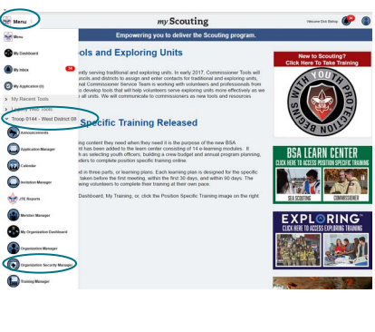
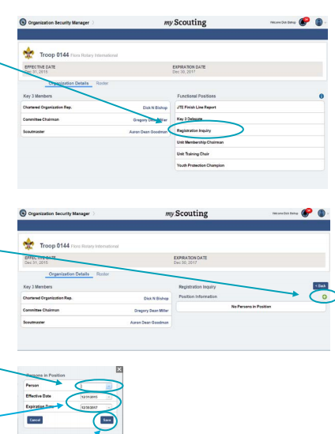
Notes:
To assign a Registration Inquiry (read only) , after logging on to my.scouting, select Menu, drop down to your Unit, then Organization Security Manager.
Select Registration Inquiry and then select the + button for drop down of registered adults. Select the adult’s andme and Save. (click)

Slide 11
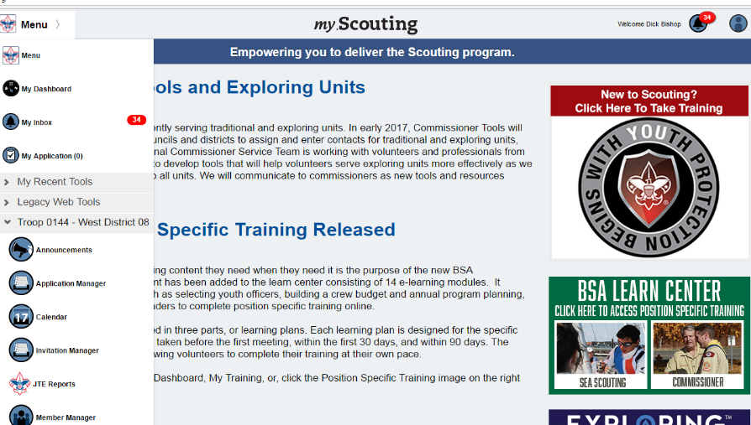
Notes:
Invitation Manager will be in the drop down under your Unit
(click)

Slide 12
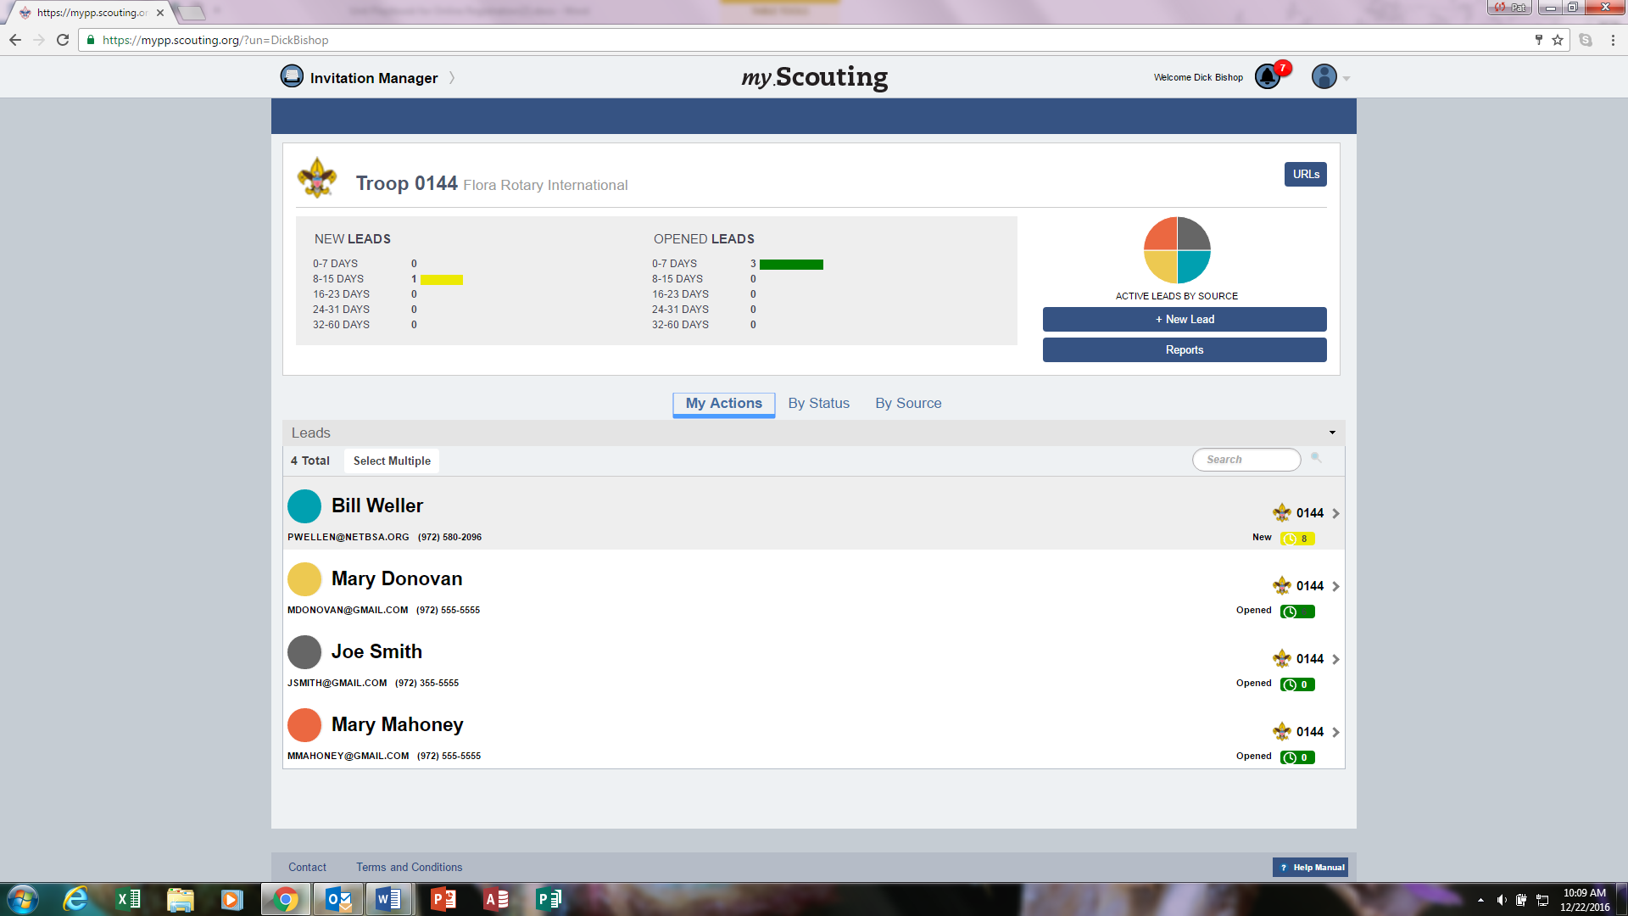
Notes:
Invitation manager will open in the My Actions tab – this tab shows you all of the requests for information on which you need to take action.
(click) You can also look at the leads by status or
(click) by source.
(click) If you want to add a new lead you can select the button for adding a lead and a new window will appear.

Slide 13
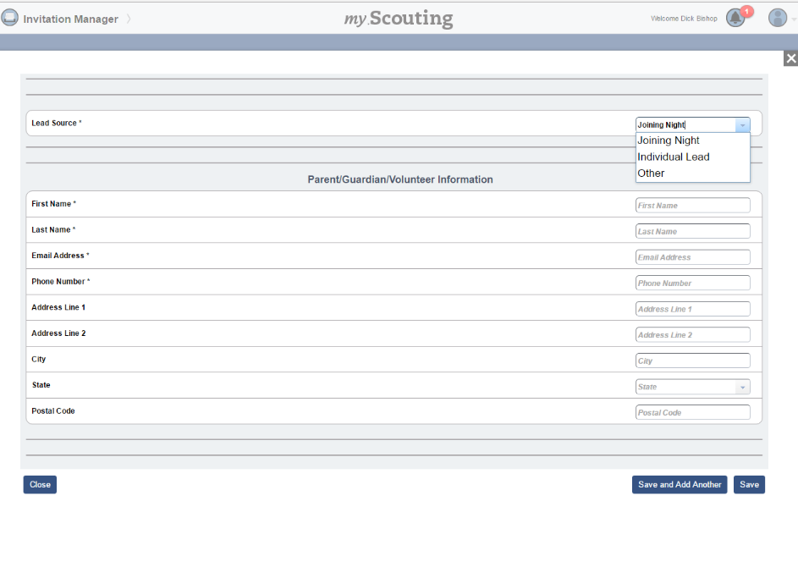
Notes:
After you select add a new lead this screen will appear. You can select the lead source from the drop down menu. You can use this to enter individual leads that you get through word of mouth.
You can also use this at joining night as your sign in page if you have internet access where you are holding the rally. One of the Key 3 would just log in to their My.Scouting account and open this page, select Joining Night as the lead source and then have the parent use the iPad or laptop to fill in their contact information then ask them to select save and add another so that the next person can sign in. Before the meeting starts someone in the unit would close this form which will take them back to the MyActions page – they would Select the By Status tab the select Joining night and select everyone in that status and send the invitation. Parents will get the invitation on their SMART phone and will be able to fill it out while they are attending the joining night or they can always fill out the paper application if they prefer to apply that way. If they apply online, One of the key 3 can go in and accept the youth applications as they are submitted and the applicant will leave the meeting having received their welcome email and their member number.
(click)

Slide 14
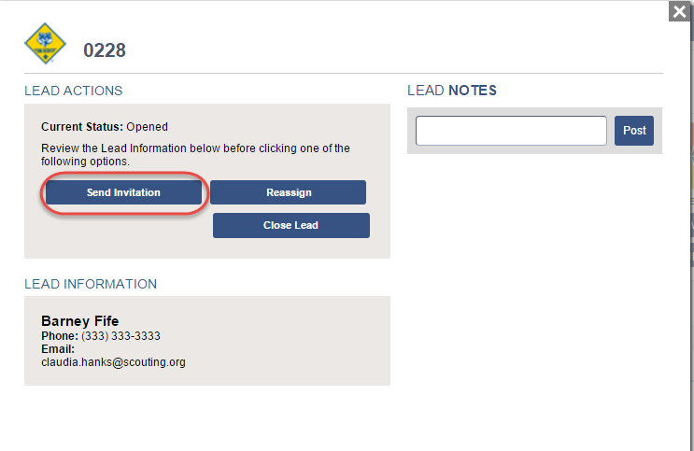
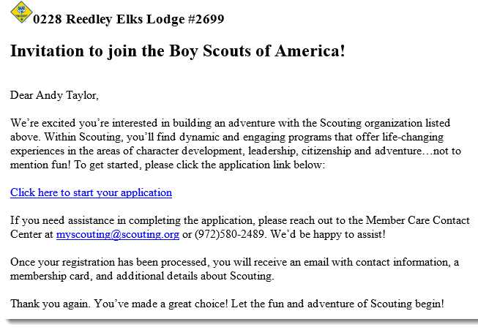
Notes:
Once you have leads in the system, you can review the lead information. You can add notes about any actions you have taken to contact the lead – this lets the others in your unit who have access to process leads know what you have done.
You can send an invitation.
You can reassign the lead to the district if there is some reason you cannot take the person into your unit.
Or, You can close the lead if the person turned in a paper application or if the person tells you they are no longer interested in joining. This will take them out of your actions and out of your reminder emails.
(click) This is what the invitation generated by the system looks like. It will have the program symbol and your unit number and your chartered organization name at the top. The link will be specific to your unit – so anyone using this link will fill out an application that goes into your Application Manager tool where you can review and accept the applicant.

Slide 15
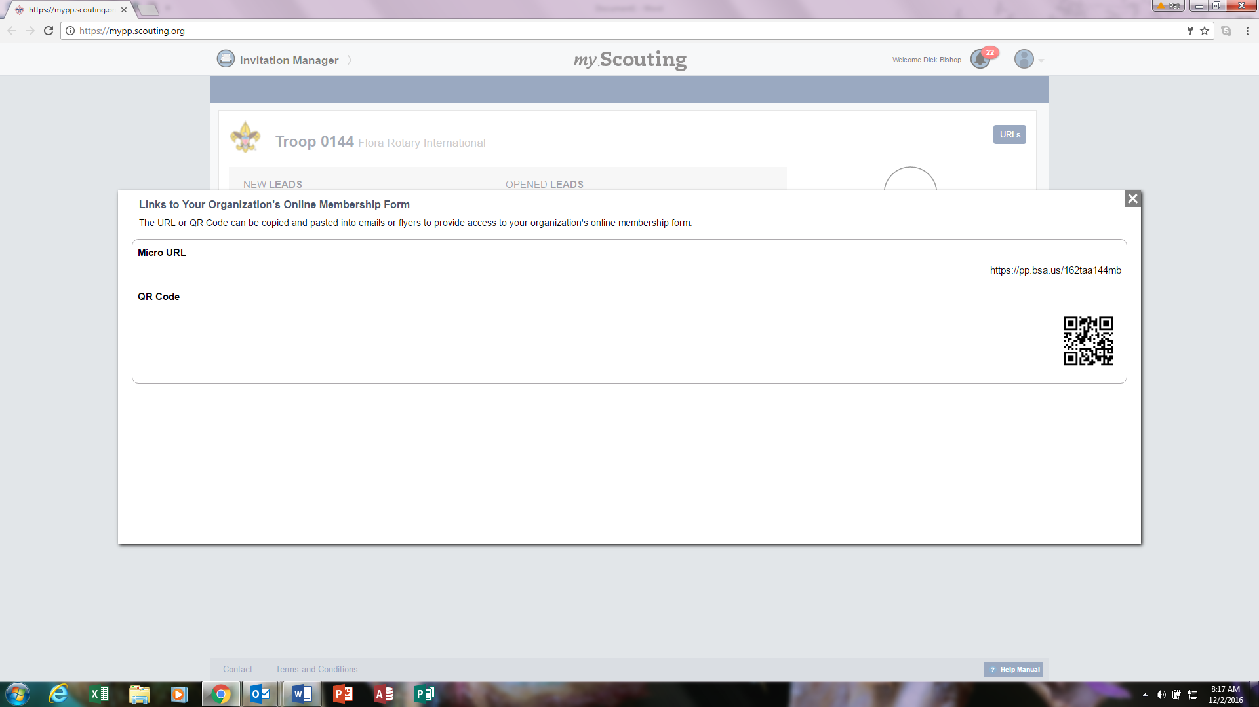
Notes:
If you don’t have internet access at the joining event, parents can still use their phones to fill out the online application. You will just need to provide the units URL or QR code that links to your units application. Select URL’s at the top right hand corner of your screen
(click) and a window will open with your unit’s URL and QR code. Just copy and paste these on your fliers or in your personal emails to invite others to join your unit.
Remember when using the URL or QR code that it is specific to your unit. If you put it out on social media and someone from Timbuktu sees it and clicks it – they are applying to your unit. So, it is best not to use this link on your social media page where the public could get to it.

Slide 16
Digital Application
Notes:
The digital application asks for the same information as the paper application. It just presents it in a format that is easy to fill using a digital device.
(click)

Slide 17
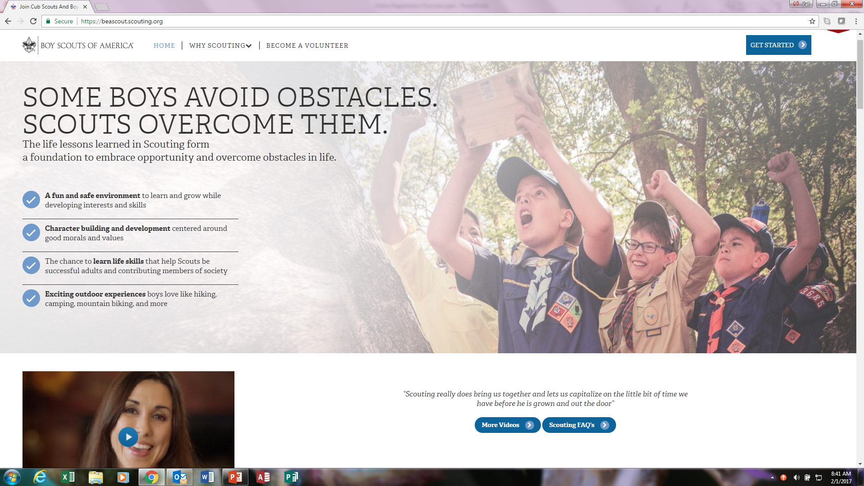
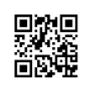
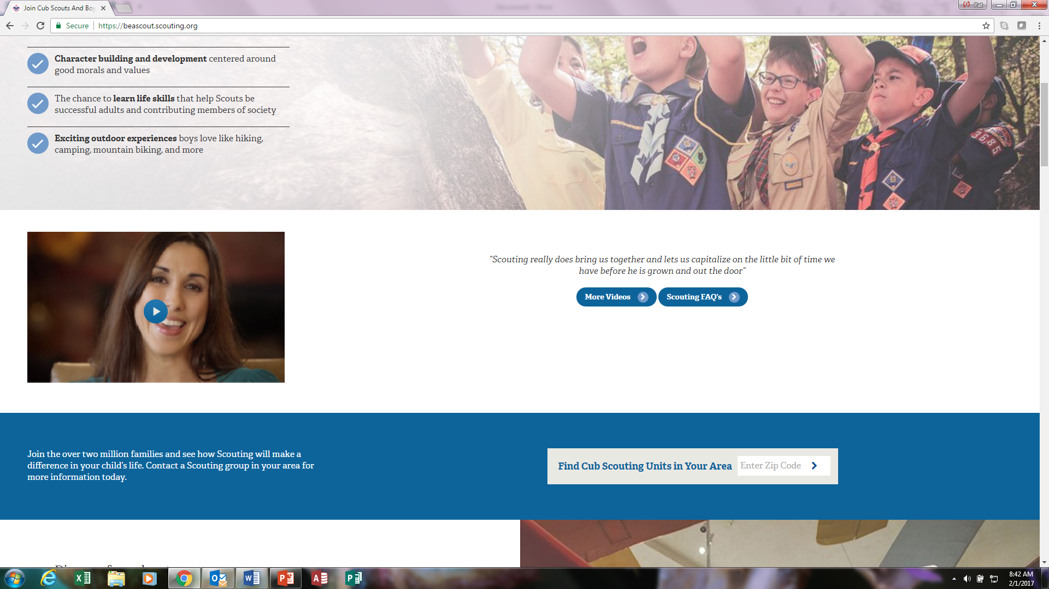
Three ways to start an application
BeAScout.org
Unit specific URL
Unit specific QR code
Notes:
There are three ways that a family who wants to join Scouting can access the online application. One way is through BeAScout which is a web portal that allows parents to input a zip code and find nearby units. The other two ways are initiated by unit – through a URL that is attached to an email (or given out at a Join Scouting event) or through the use of a QR code which I just showed you how to access in the Invitation Manager tool.
(click)

Slide 18
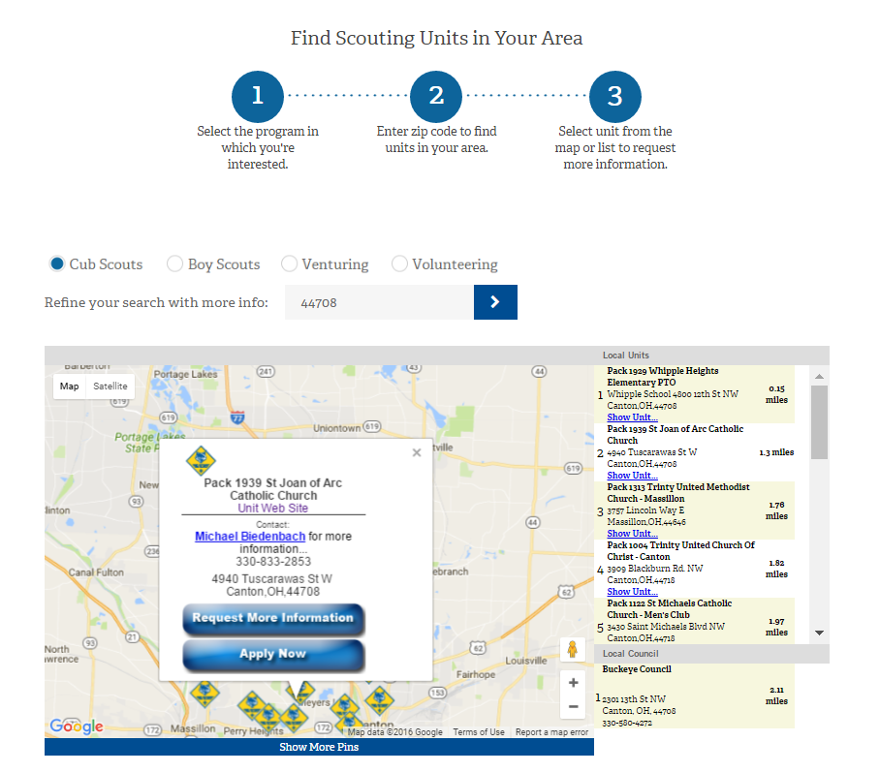

BeAScout PIN– Apply Now
Sample Unit Join Card
Notes:
If joining from BeAScout is enabled, this is what people searching for units will see.
You can print your unit’s QR code or URL on recruiting cards, posters, flyers, etc.

Slide 19
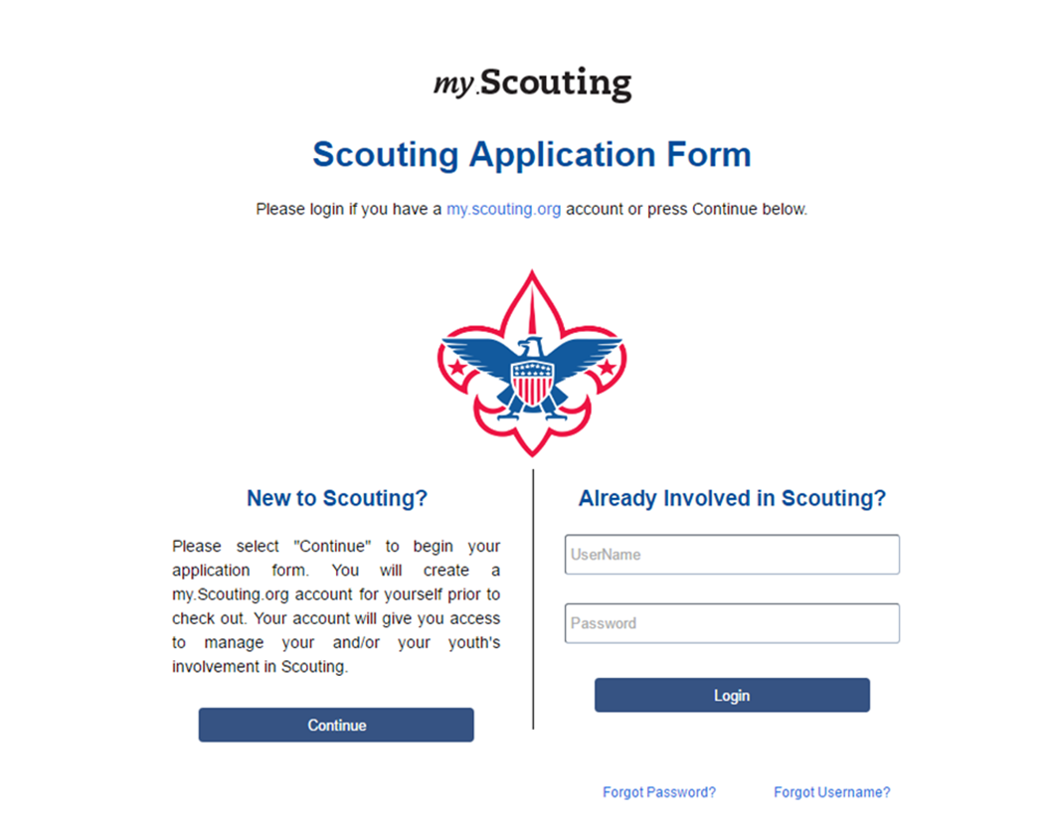
Notes:
When process starts, person asked to create a my.scouting.org account (or use their existing one)

Slide 20
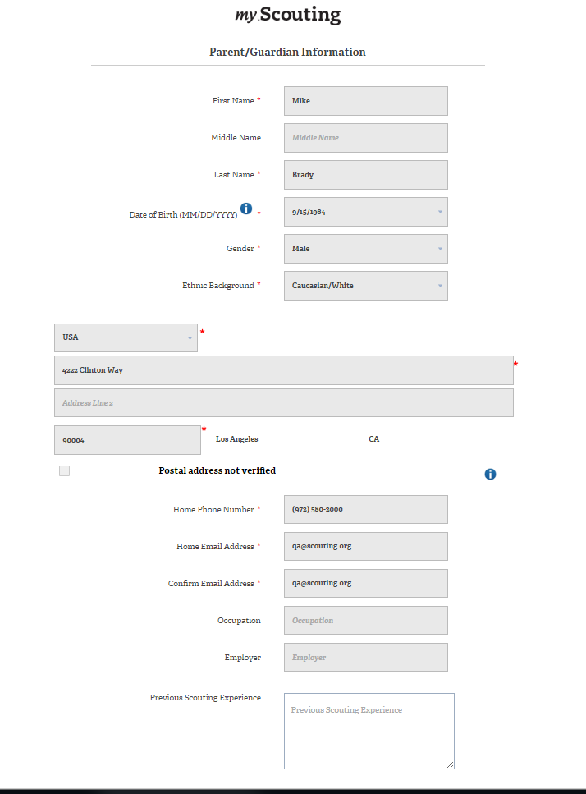
Notes:
Fill in parent information first

Slide 21
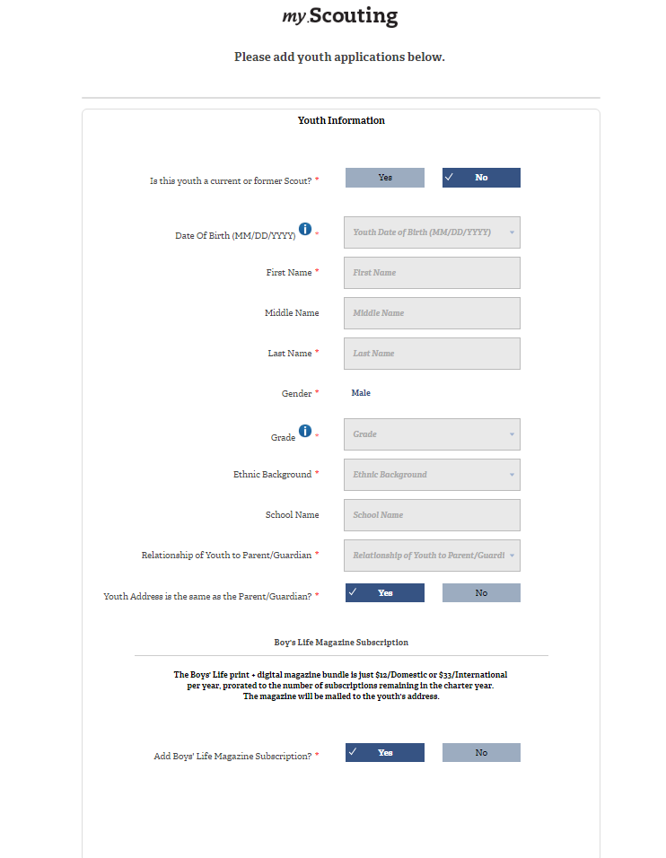
Notes:
Fill in youth information
Option to subscribe to Boys’ Life (Note: Yes is the default.)

Slide 22
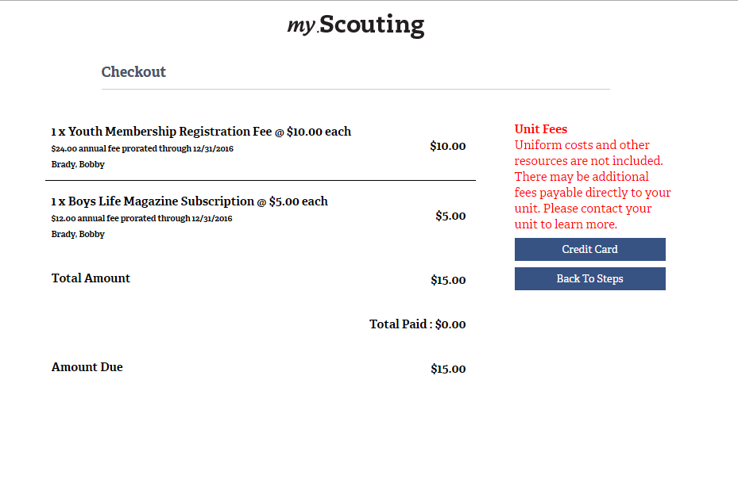
Notes:
Amount due is calculated automatically based upon how long until unit recharter time.

Slide 23
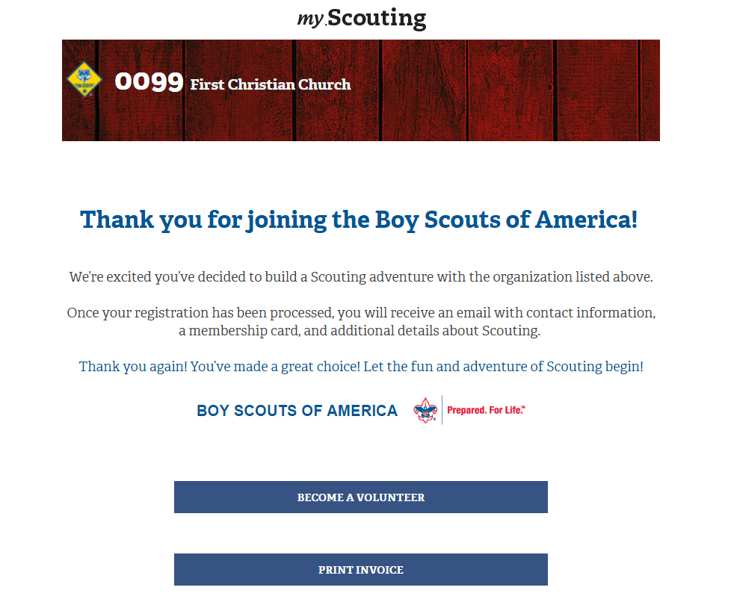
Notes:
Application completion notice

Slide 24
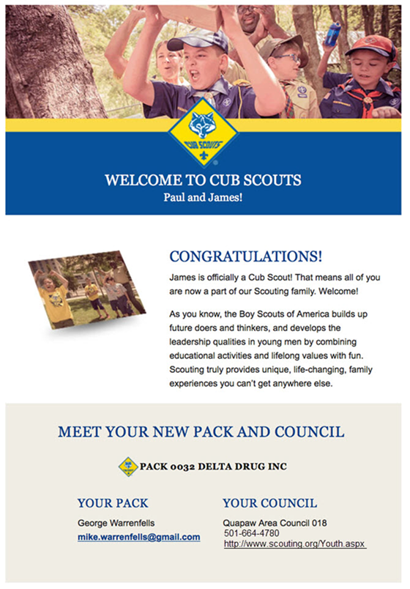
Notes:
Info about new program.

Slide 25
Application Manager
Notes:
Once the application has been completed and submitted, how does your unit process it?
Now lets look at the tool where you can review and accept applicants.
(click)

Slide 26
Key Unit Roles in Application Manager
Full authority to accept or reject a youth application is given to:
  Unit Leader (Cubmaster, Scoutmaster, Crew Advisor, Coach, or Skipper)
  Committee Chair
  Chartered Organization Representative
  Institution Head (Executive Officer)
Read-only access is granted to:
  Unit Membership Chair
  Registration Inquiry
Notes:
Full authority to accept or reject youth applications is given to the unit key 3 and the institution head.
By rule, no one else, including district and council staff, can approve applications.
Members of the unit key 3 can optionally assign the functional roles of Unit Membership Chair or Registration Inquiry in the “Organization Security Manager” within My.Scouting and these people will have read-only access to Application Manager.

Slide 27
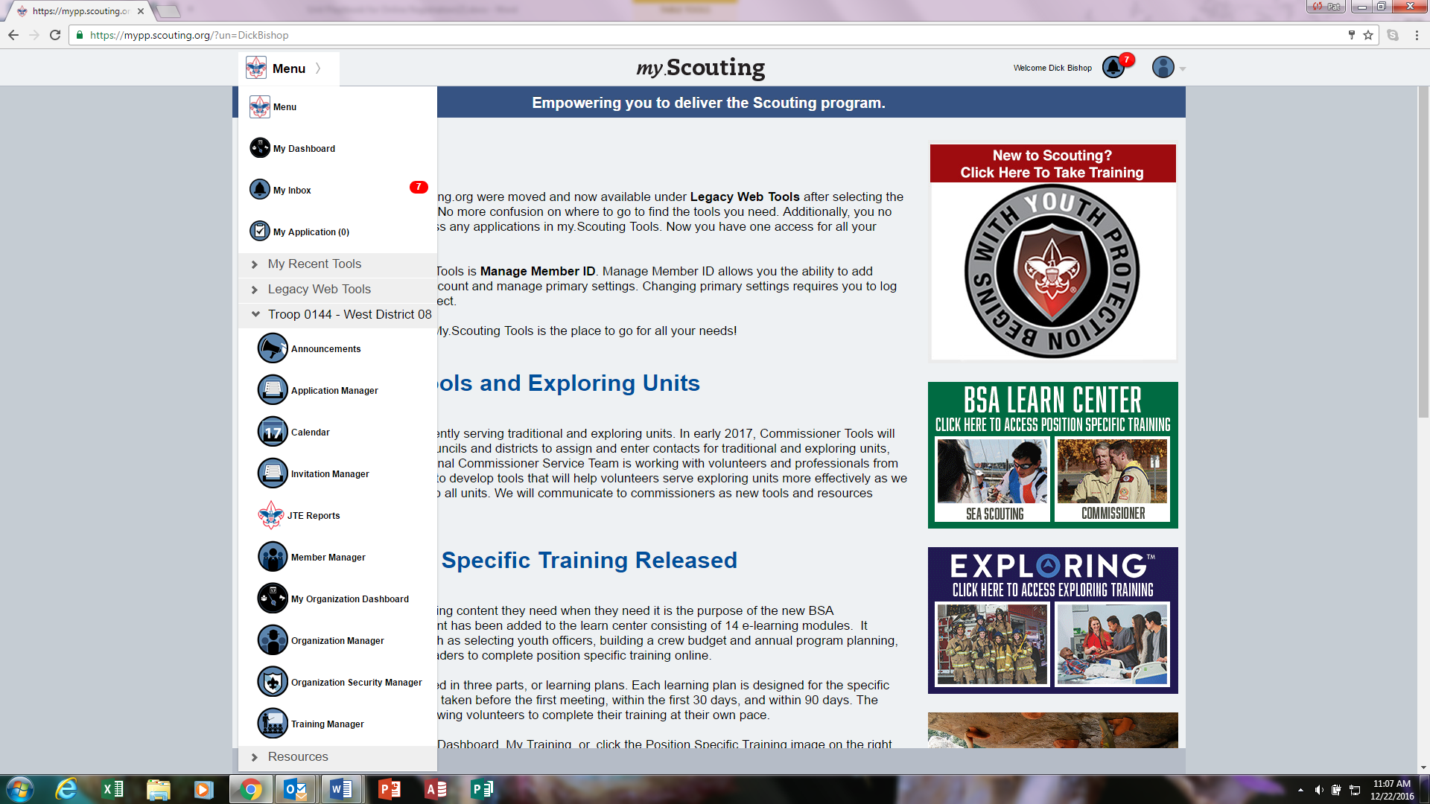
Opening Application Manager
Notes:
When you log in to your My.Scouting account and select the drop down menu, you first need to select your unit name and then application manager.
(click)

Slide 28
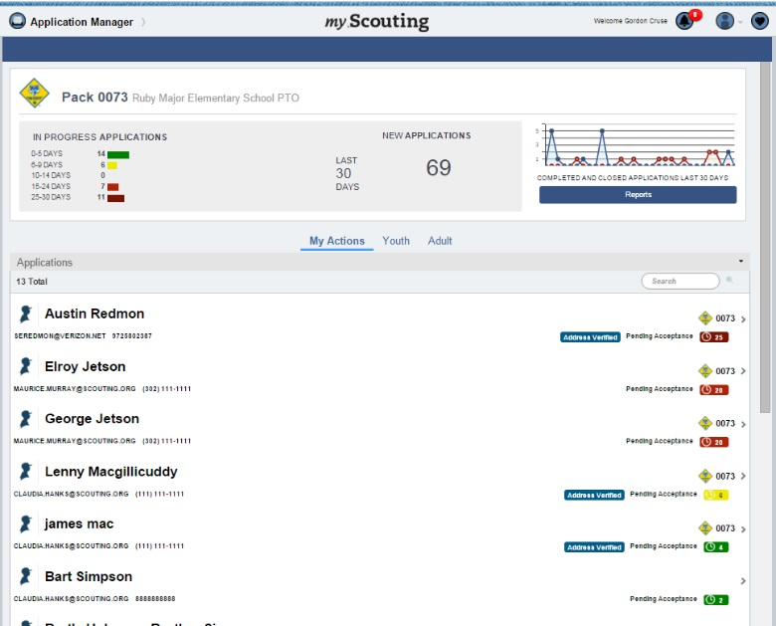
Notes:
That will take you to your (click) “My Actions” tab in Application manager. (click) On the dashboard you will see a summary of the applications in progress by age – remember that all applications will time out if you don’t accept them within 30 days. And, the clock does not start over with each action you take in the system – it starts the day the applicant presses the submit button until you take some type of action that completes or closes the application.
(Click) You can also see how many applicants have come in over the last 30 days and how many completed and closed applications have been processed over the last 30 days. As well as a button for downloading system reports.
(click) On the right hand side of the screen you can see the status that the application is in – here we can see that the application is pending acceptance.
(click) You can select the name of the applicant and open the record to view the information and take action on the application.
(click)

Slide 29
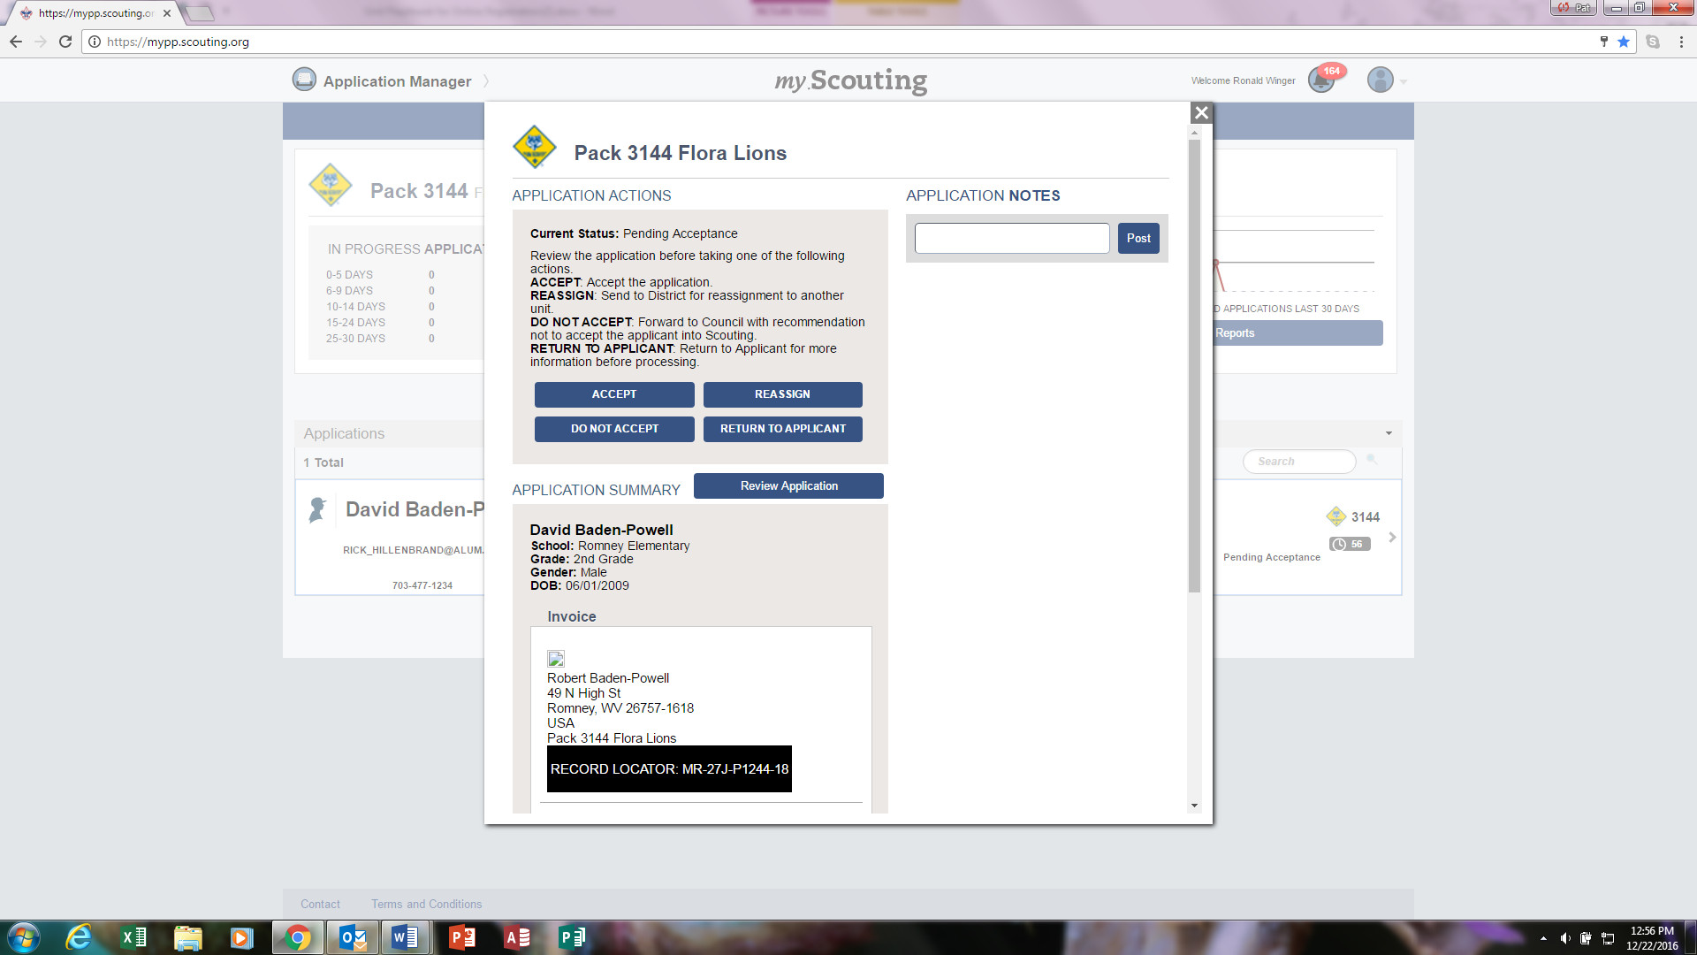
Acting on an application
Notes:
When you open an application you will see the actions that you have available in the blue buttons. (click) You can accept the applicant, reassign the applicant to the district so the district can find another unit for the applicant, return the application to the applicant because you want additional information, or you can recommend this person not be accepted in Scouting. We will go over each of these actions in more detail.
(click) First let’s review the application – you have some summary information visible that you can see without opening anything else – It will show you the basic information on the application. As you scroll down you will see the record locator for this applicant and their payment information.
But – you might want to look more closely at the information an applicant has provided. To do this you would select Review Application.
(click)

Slide 30
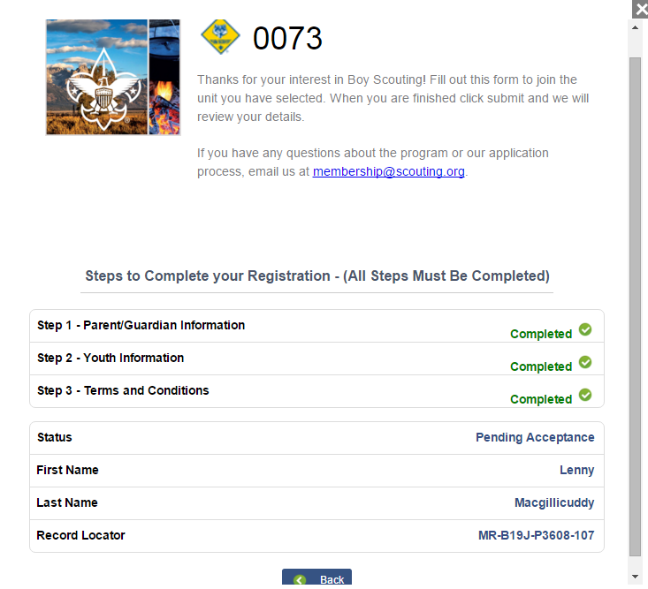
Reviewing the Application
Notes:
You can check each of the three parts of the application by clicking on the step – the form will open and you will see all of the field that are on the unit’s copy of the paper application.
(click)

Slide 31
Accepting an Application
Notes:
After you have reviewed the application and you know you want this youth in your unit you can press the accept button and they will move to completed status. Pro-rated fees will be paid by credit card and they will be on your membership roster in My.Scouting. They will also receive a welcome email from the National Service Center and if your unit has elected to do so, they will also receive an auto generated welcome email with your unit’s message.
Mount Baker Council only allows payment by credit card, so applications will immediately move to completed status.
(click)

Slide 32
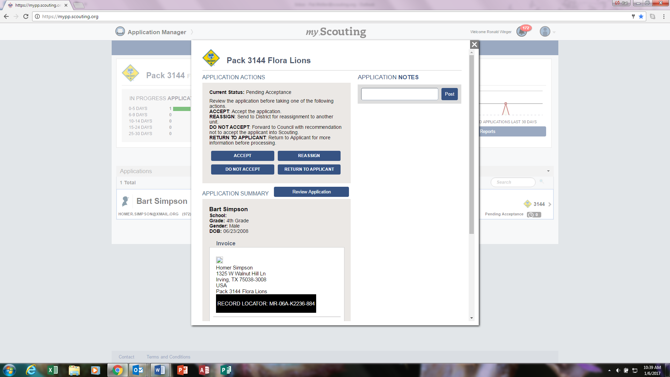
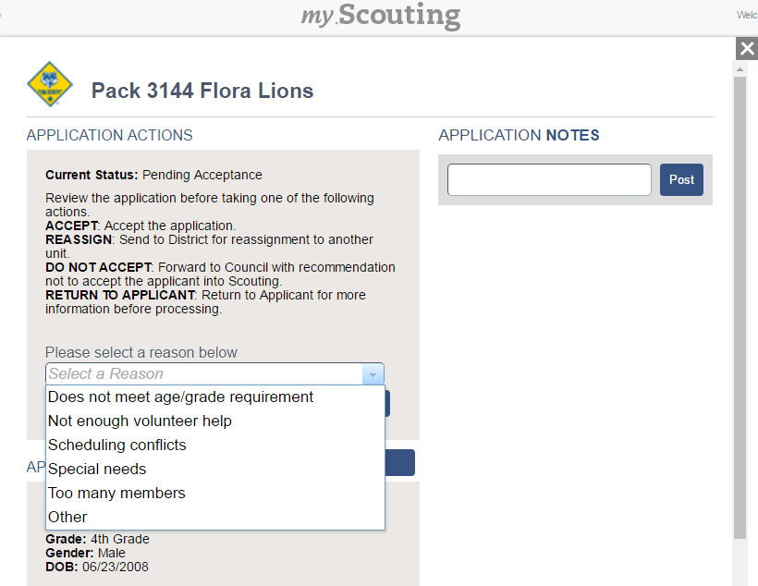
Reassign
Notes:
If you select reassign, you will be asked to give a reason that you are not accepting this youth or adult into your unit. You will select from a drop down list. The application will then be forwarded to the district for one of the district Key 3 to reassign to another unit. If you look in the youth or adult status tabs you will see the application in Pending reassignment status until someone at the district takes action.
(click)

Slide 33
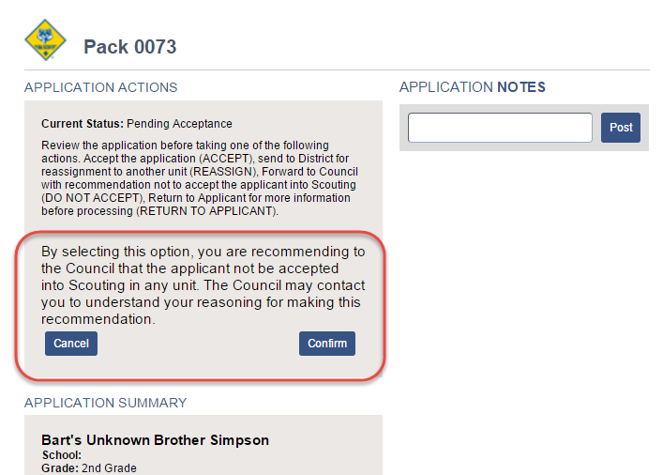
Do Not Accept
Notes:
If you select do not accept this means that you are saying they should not be accepted into any Scouting unit. You will be asked to confirm this selection. You should not give your reason on this screen – if the council has questions they will contact you for further explanation.
(click)

Slide 34
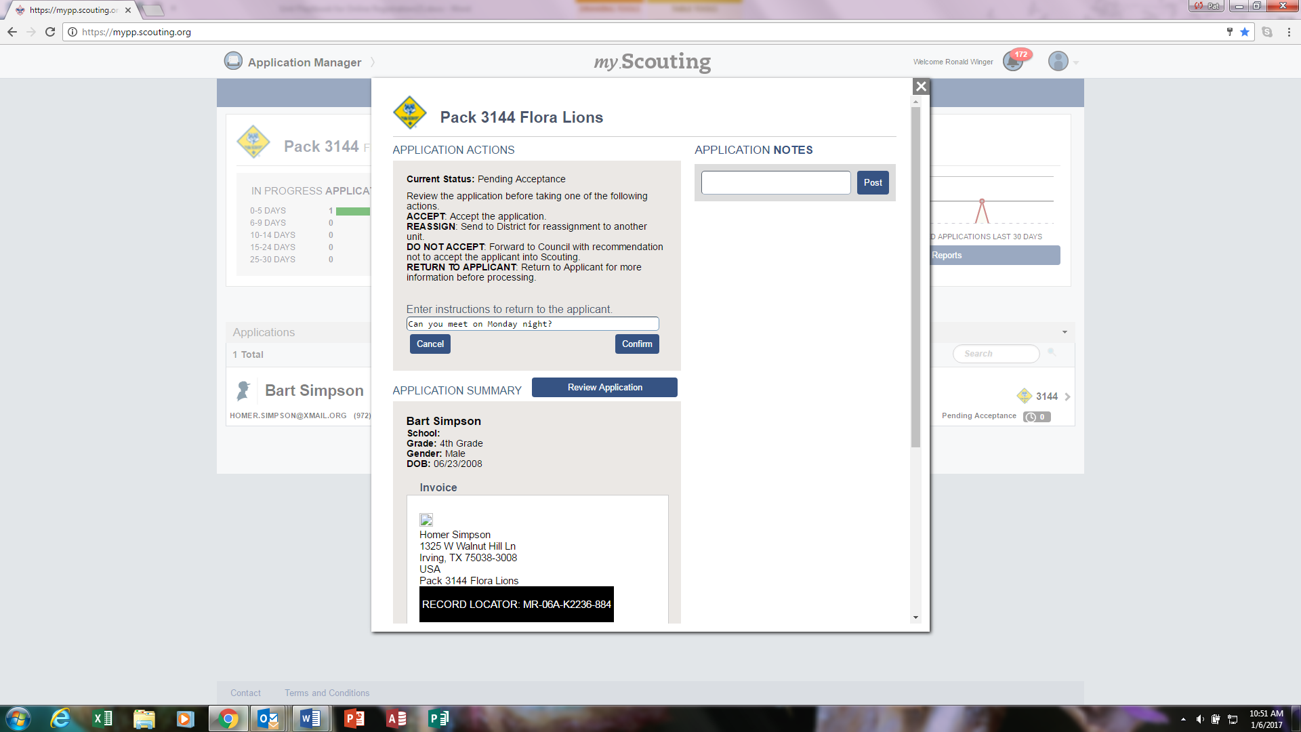
Return to Applicant
Notes:
Sometimes the unit might want a little more information from the applicant, so there is a way to return the application and write a short message explaining the additional information you need from the applicant. When confirm the message, an email will be sent to the applicant asking for the additional information. If you do not hear back from the applicant, you may want to follow up by other means to ensure the application is processed within the 30 day time limit.
(click)

Slide 35
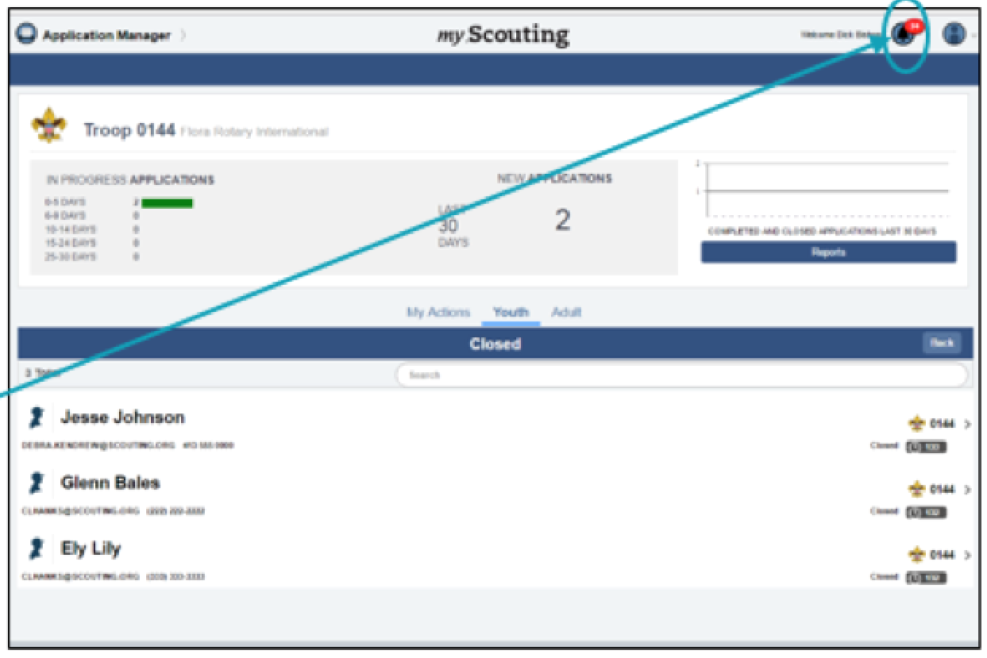
Application Manager Notifications for key 3
Notification icon in upper right corner of My.Scouting page
  Notification on bell icon
  Red circle with number of notifications
Email to address in My.Scouting profile
  2 reminders per week
Notes:
Members of the unit key 3 will see a notification that they have actions to take when they login to their My.Scouting account. (Note: You should clear the reminders when you have dealt with them.)
Email reminders will also be sent twice a week if there are pending actions.

Slide 36
What the New Online Registration System Is
An alternative to traditional paper applications for registering youth who are new to Scouting
The next step in reducing the amount of paper you must handle
A work in progress
Notes:
This system joins other systems like online recharter and online advancement
Additional features to address limitations in the system are under development

Slide 37
What the new online registration system is not (currently)
Mandatory
Available for adult applications
Used with Learning for Life units (including posts)
Used to renew membership as a part of the recharter process
Used to transfer people from one unit to another
Used when forming a new unit
Notes:
While we think the system will be useful, it is not mandatory to use it, nor will it become mandatory in the near future.
In our council, the system is currently only used for registering youth new to scouting, no transfers including Webelos crossing over to Boy Scouts. Note that youth is defined as under 18, even in units like crews and ships that permit individuals to participate as youths until age 21. This is due to a national rule change that requires all individuals who are 18 or older to undergo background checks and complete youth protection regardless of program. While you may see some materials on the National site about online adult applications, there are currently several significant problems with how adult applications are processed, so our council will not be using the online application system for adults until these issues are resolved.
Because the system does not currently process transfers, it should not be used for graduating Cub Scouts who are joining a troop. It should not be used for people who are leaving their previous unit to join yours (because they moved, etc.)
Initial unit charter must still be done with a paper applications. Once initial charter is accepted and posted, additional Scouts can join using the online system.

Slide 38
Collecting membership fees
Only fees due to BSA National are collected using an online application:
  Online payment via credit card within application manager
  $24/year National Membership Fee (prorated)
  $12/year Boys’ Life subscription Fee (prorated)
Unit dues must be collected separately
Notes:
People who pay by credit card as part of the online application process will be notified that there may be additional fees due charged by your unit, but there is no way for them to pay these fees using the online application system.
The system recognizes LDS units and will not charge anyone who joins them a membership fee (but will charge them if they elect to receive Boys’ Life)
By default, the option to receive Boys’ Life is selected, but the applicant can unselect this option.
The amount due is calculated at the time the application is submitted by the parent, not the time you approve the application.

Slide 39
Key Deadlines in the system
New leads (requests for information) must be handled within 5 days
New applications must be accepted or rejected within 8 days of application
Entire process including payment processing by council office done within 30 days of application
  Since payment is made by credit card, nothing to turn in to council
Notes:
If new leads or applications are not handled within the time period above, the lead or application will be automatically removed from your unit and sent up to your district.
If payment is not processed within 30 days, the application will be automatically rejected.

Slide 40
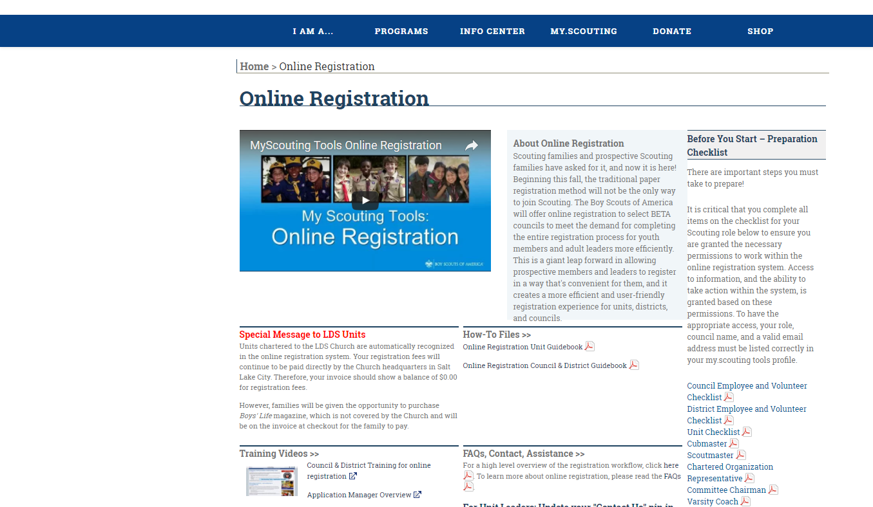
www.Scouting.org/onlineregistration
Training
Guidebooks
Checklists
Notes:
This is the national online registration site.
Scouting.org/onlineregistration provides online training and guidebooks that provide step by step instructions. There are also other resources such as frequently asked questions that you may also find helpful.
(click)

Slide 41
Contacts
Susan McCaughan, Mount Baker Council Registrar
susan.mccaughan@scouting.org
425-338-0380
Steven Davis, Mount Baker Council Membership Chair
MountBakerMembership@gmail.com
425-218-4647
BSA National Service Center & IT Support
myscouting@scouting.org
972-580-2489

Slide 42
Questions??

