Slide 1

Unit Renewal 2026
2026 Unit Renewal will still be separated from member renewal

Slide 2
Sept 1st
Unit Renewal Tab becomes available.

Slide 3
Fill Necessary Adult Leader Positions
Cubs: Scouts BSA:
IH/Executive Officer IH/Executive Officer
Chartered Organization Rep Chartered Organization Rep
Cubmaster Scoutmaster
Committee Chair Committee Chair
2 Committee Members 2 Committee Members
At least 1 Den Leader

Slide 4
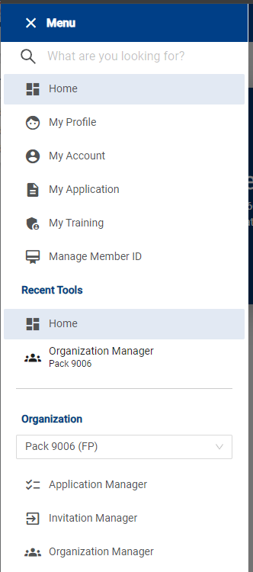
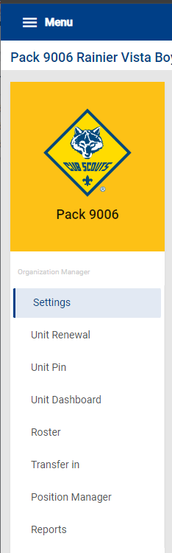

Slide 5
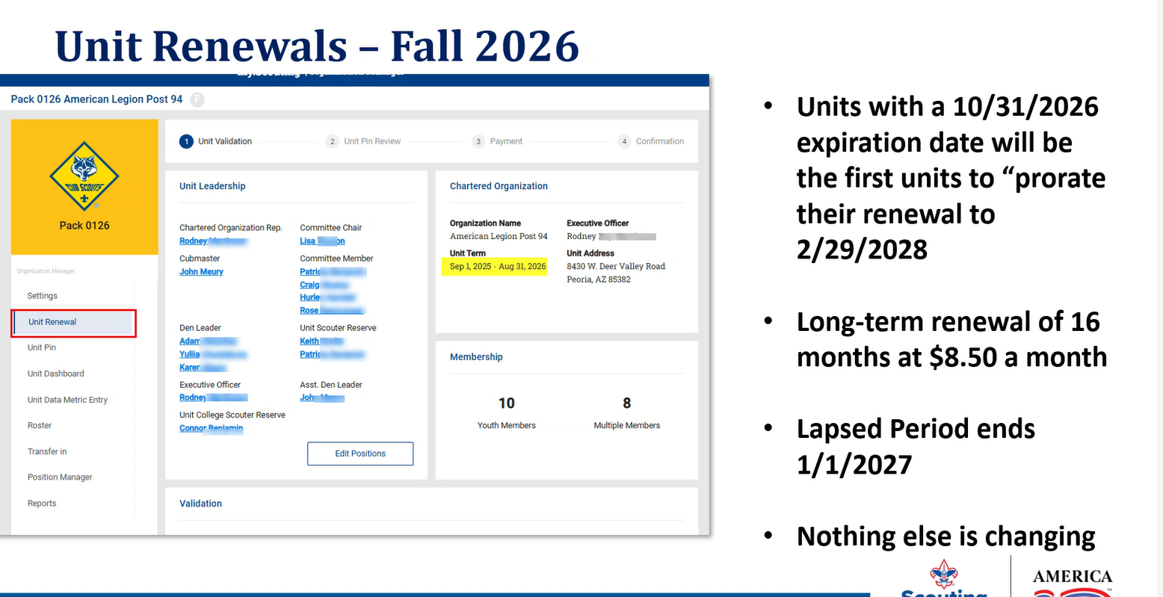

Slide 6
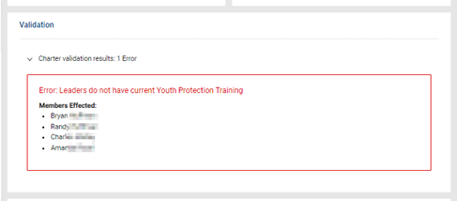
Each time you open Unit Renewal, it automatically checks Validation:
  Errors must be resolved (expired Safeguarding Youth, missing leaders)
  **Leaders who have NOT taken the 90-minute Safeguarding Youth course, cannot
  Take the 20-minute Refresher Course. They have to take the 90-minute course.

Slide 7
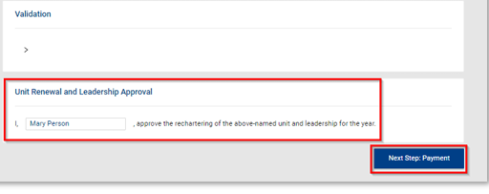
Once you are happy with the roster, and there are no errors, the charter is signed (type your name) and you proceed to payment
Online charter renewal does require payment to complete:
Credit Card--3% fee or
E-Check (Bank Account Withdrawal) --$1.00 fee

Slide 8
Renewing Youth
Make a Plan
Every member renews themselves—all Adult Leaders and Parent/Guardians will receive an email and text message to renew themselves and/or their Scouts.
                OR
Key 3 renew all or some of the youth (dependent on popcorn, fundraisers, etc).
COR renews Adults
Lapse period goes away 1/2027. Those Expiring 12/31 will DROP OFF THE ROSTER 1/1/2027.

Slide 9
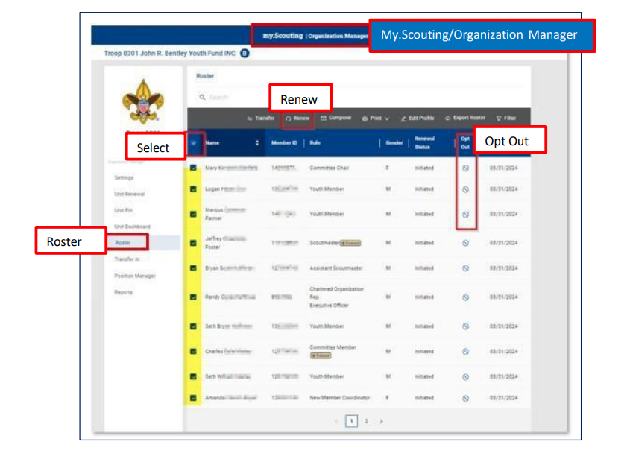
my.Scouting -->Organization Manager-->Roster, you can Opt-Out a member from renewing if you know they have left the unit.

Slide 10
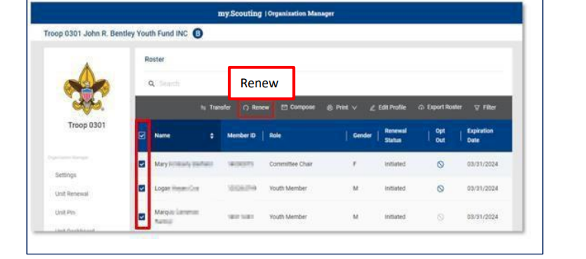
Select member(s) to renew, then click on “Renew”

Slide 11
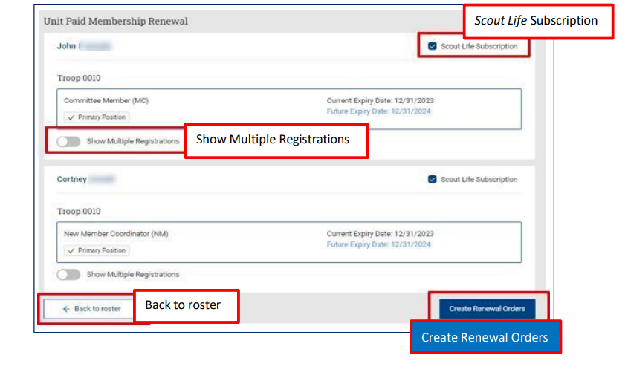

Slide 12
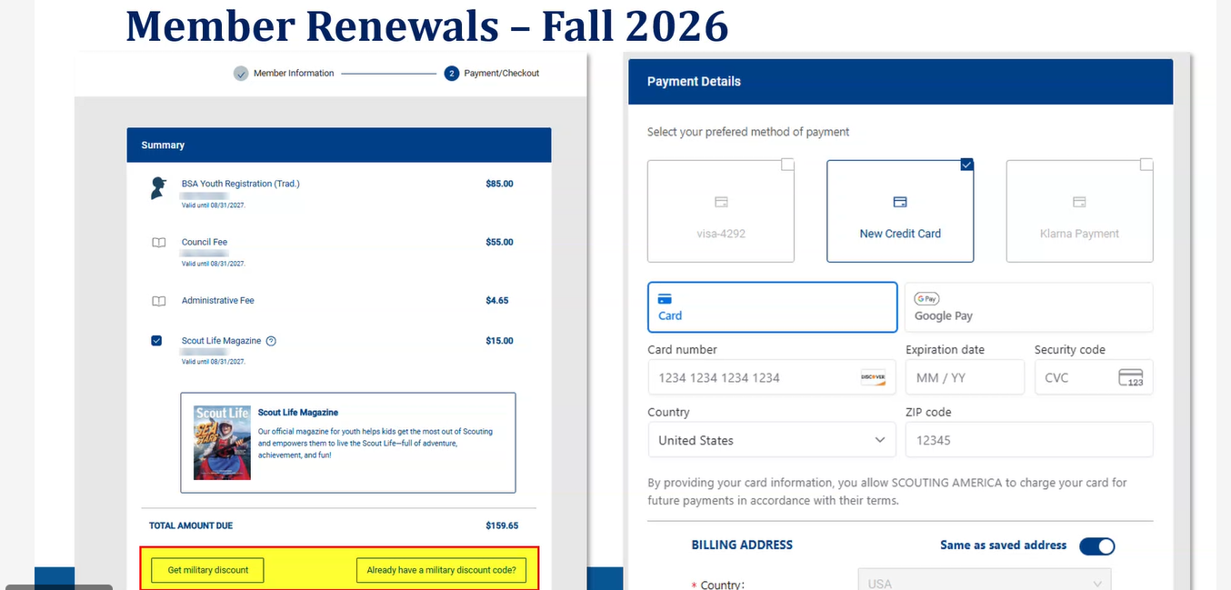

Slide 13
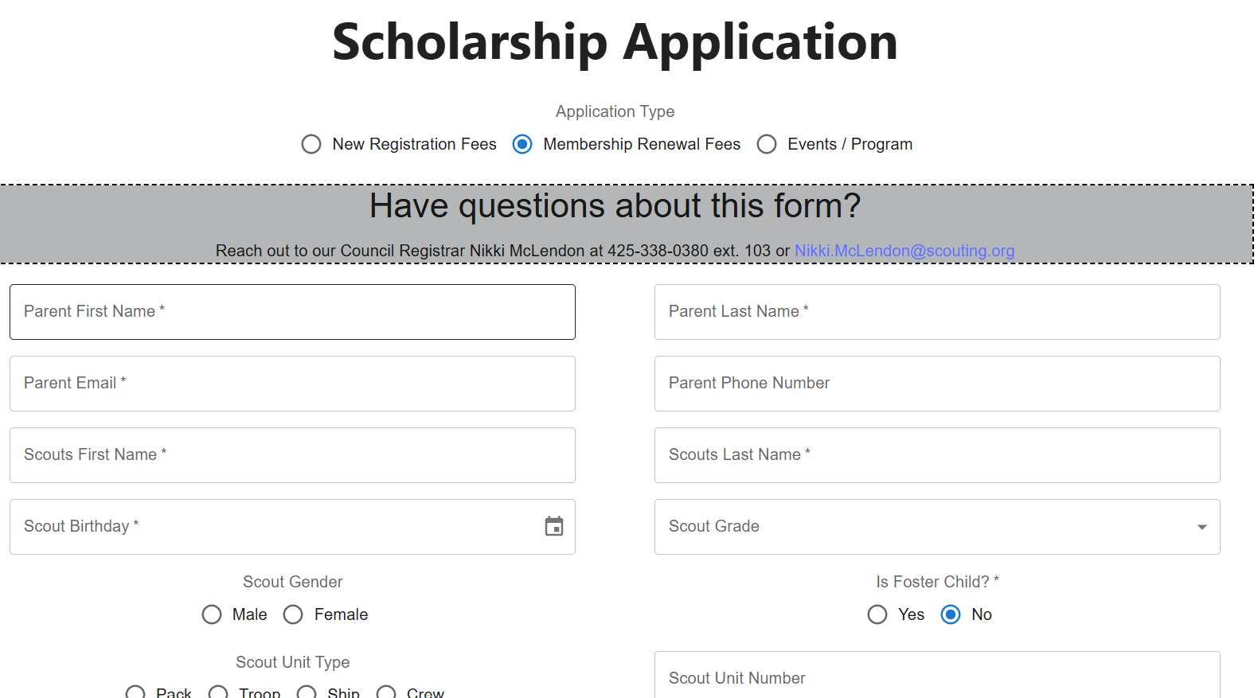
Scholarship Fund Membership Assistance

Slide 14
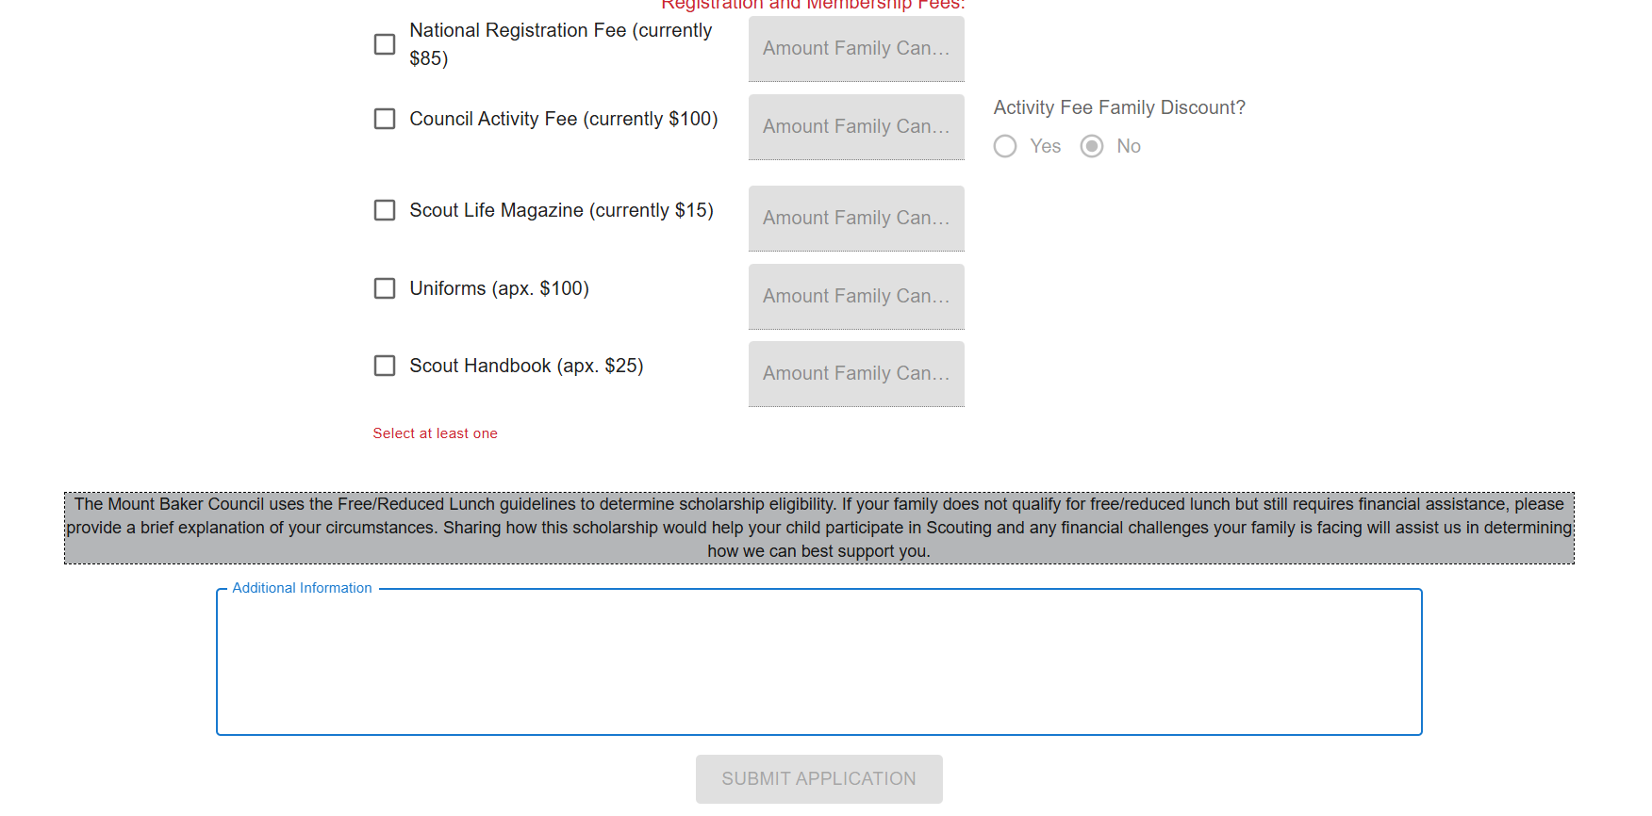
https://mountbakerscouting.org/membership/scholarship-fund-membership-assistance/

Slide 15
